Slide 1
Datathon
Parana Case
November 13, 2020
Prepared by Humza Butt, Kevin Zhang, Yilin Lu, Anita Smirnova
Notes:
Humza

Slide 2
Agenda
Parana
Executive Summary
Background / Problem Setting
Problem Statement
Managerial Question
Analytical Question
Key Data Sources Overview
Modeling Approach
Model Trustworthiness
Key Finding
Recommendation
Next Steps

Slide 3
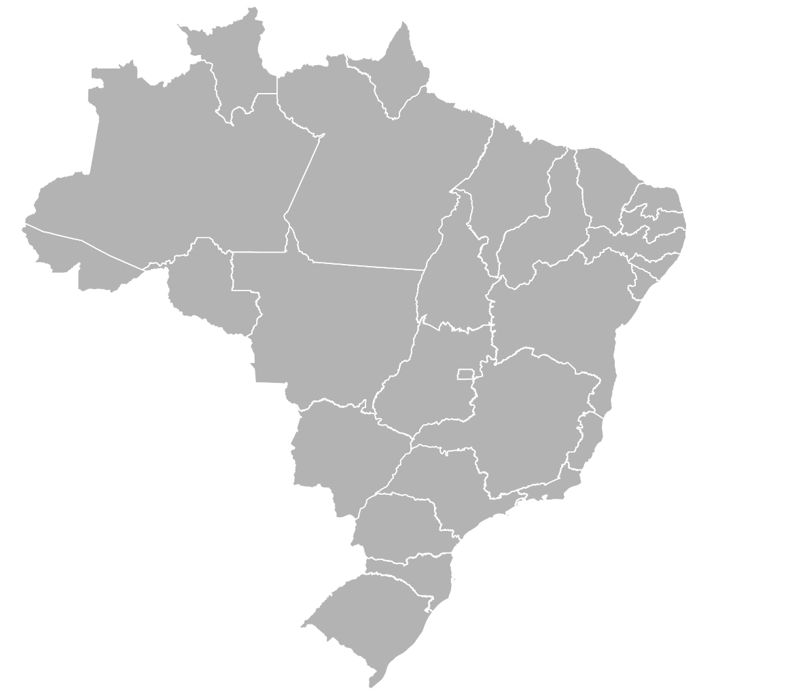
Executive Summary
Parana Case
Business Problem
Data Used
Inefficient delivery of orders;
“Sticker Shock” reason is unknown;
Complexity of shipment with different sellers’ fulfilment timelines;
loss of potential sales
lower customer satisfaction
Sample of 100k is drawn from 2016-2018 at multiple marketplace in Brazil
Main Findings
Recommendation
5 factors influencing missed delivery times: product weight, product size, distance of seller to customer, confirmation time from LP, and seller preparation time;
93.2% SLA for LPs in terms of delivering orders on time;
12 day safety net can be reduced, while maintaining the SLA and reducing sticker shock;
Sellers are not geographically dispersed enough.
Flag new orders that deviate from estimated delivery time;
Add a KPI that measures time to confirmation from purchase;
Reward LPs that speed up the confirmation process;
Incentivize LPs to reduce safety net;
Partner with local sellers in locations where we are not prevalent in relation to customers
Notes:
Humza

Slide 4
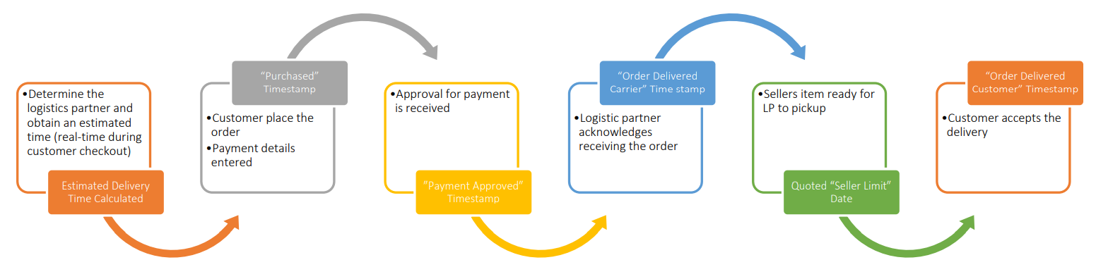
Business Problem
Current Situation
Business Overview
Problem Statement
Parana is one of the largest e-commerce websites in Brazil;
Connects small businesses to retail channels;
Merchants can sell their products on the platform and ship them directly using Parana’s logistic team;
Logistic partners are separated into four regions:
North, South, East, West;
Sao Paulo partner contains the largest customer base.
Business model requires efficiency and timely delivery of orders:
Otherwise, it negatively impacts customer satisfaction and therefore affect sales;
Beyond missing deadlines, general long estimated delivery times leads to “sticker shock” and loss of potential sales.
Order Fulfillment Process
“Sticker Shock”
Delivery Status Problem

Slide 5
Managerial and Analytical Objectives
Problem Statement
Managerial question
How to shorten the estimated and actual delivery time without sacrificing the safety of logistic partners?
What are the main reasons for missed delivery?
Analytical question
What variables are statistically significant in impacting the estimated
and actual order delivery time without missing delivery dates?
What are the major factors resulted in miss delivery time?
What are the major factors to estimate delivery time ?
São Paulo

Slide 6
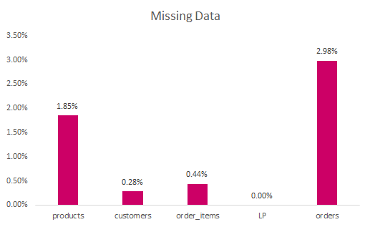
Key Data Sources
Handling Data
Problems in Data
Data Sources Used
We considered rows where orders were cancelled or unavailable missing.
The coordinates for sellers and customers were the bulk of the missing data.
Handle missing data by dropping them.
Data | Number of Rows | Number of Variables | Used
parana_orders | 99441 | 8 | Yes
parana_products | 32951 | 9 | Yes
parana_order_items | 102425 | 12 | Yes
parana_customers | 99441 | 7 | Yes
parana_LP | 27 | 3 | No
Description of Data
Sample of near 100k orders is drawn from 2016-2018 at multiple marketplace in Brazil.
An order can have multiple items, but each item might be fulfilled by a distinct seller.
Customers, products, orders, and sellers all contain unique IDs.
Notes:
Humza

Slide 7
Modeling Approach
Clustering & Regression
Model Overview
Model Accuracy
Model 1: Cluster Model
K-means algorithm is used to group orders based on the similarities of their characteristics
Unsupervised learning looks for undetected patterns
Model 2: Linear Regression Model
Cross validation study that partition data into training/validation/test sets in 50%/25%/25%
Predictive analysis models the relationship between predictors and estimated delivery time
Model 1: Cluster Model
Found optimal K clusters by minimizing variance within clusters
Model 2: Linear Regression Model
To determine accuracy, evaluate outputs from the model analysis and determine RMSE.
How much of the outcome are explained by the model. R Squared 57%.
How far are the predictions from actual outputs. RMSE 5.87.
The RMSE for training, validation and test sets are similar, indicating there is no overfitting issue.
Cluster Variables and Response Variable
Regression Predictors and Response Variable
Variables
day_purchase_carrier
day_purchase_seller
day_seller_delivered
total_product_weight
total_product_size
distance
Product size
Response Variables
Cluster Group
Cluster Label (added after modeling)
Predictors
customer_state
product_category_name
item_count
Dist_seller_customer
Freight_value
Month
Response Variable
Days to deliver after purchase
Estimated Delivery Time
Validation Variables
Estimated Delivery Time

Slide 8
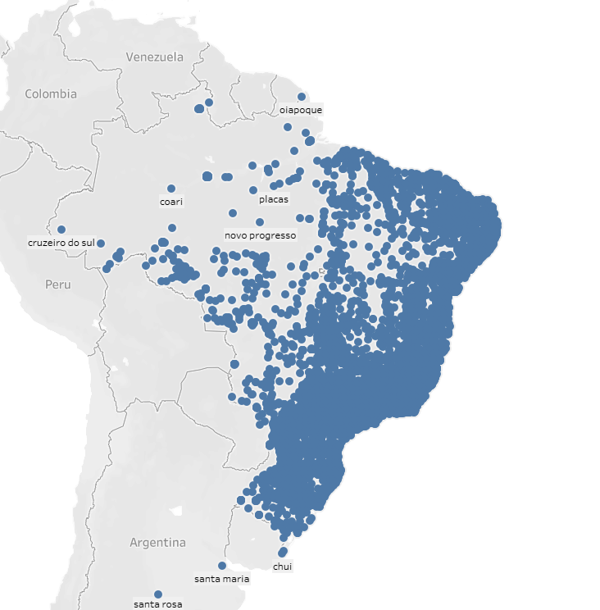
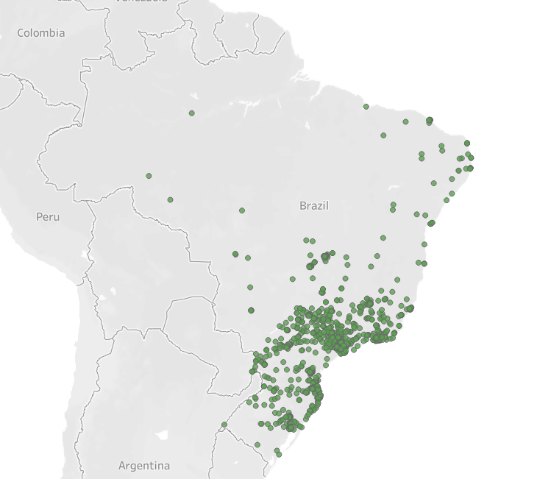
Key Findings
Geographical Locations
Customer Location
Seller Location
Notes:
Sellers and logistic partners are in inefficient areas where customers are.

Slide 9
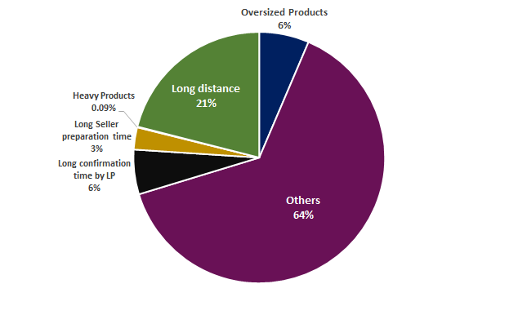
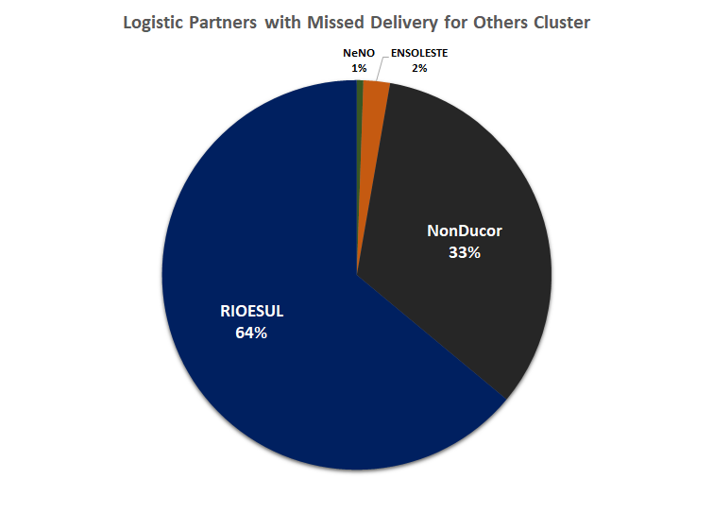
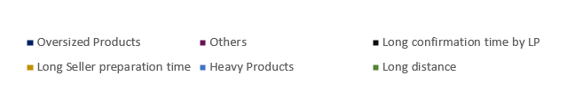
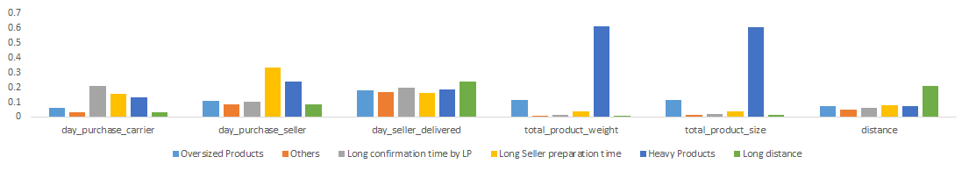
Key Findings
Cluster Groups
Reasons for Missed Delivery
Cluster Labels
Oversized Products: The size or volume of the products in an order taking up space causes missed delivery times.
Other: no single dominant reasons why estimated delivery time was missed
Long Confirmation Time by LP: confirmation from logistic partners that they received requests from customer purchase date.
Long Seller Preparation Time: the length of time a seller takes to confirm an order is ready to be picked up by LP can lead to missed delivery.
Heavy Products: the heavier the products the more likely the estimated delivery time will not be met.
Long Distance: distance of seller to customer was the dominant influence for missing delivery time.

Slide 10
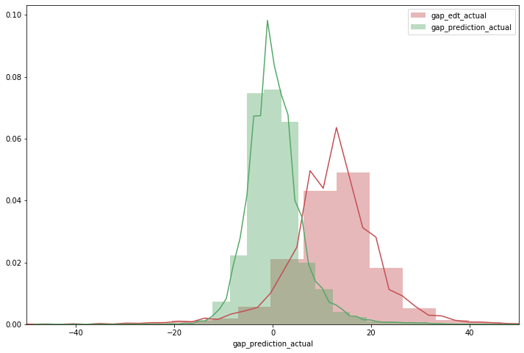
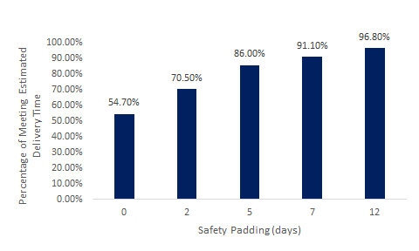
Key Findings
Predicted vs Actual Gap
Regression Model Overview
Model Performance Variable
Gap between Estimated Delivery time and actual delivery (in days)
Gap between Predicted Delivery time and actual delivery (in days)
Model Interpretation
Logistic Partner has 93.2% of time meeting the estimated delivery time with average gap of 12 days (safety padding)
Predicted model has 54.7% of time meeting average gap of 0 days(safety padding)
Regression model to predict estimated delivery time can minimize the “sticky shock”
At the cost of higher missing estimated delivery.
Still a better way than the L.P.’s current method
Notes:
After we have fitted the regression model with the variables identified early, we have otained the predicted result
The key measuring variables: the day gap between estimated delivery time and actual delivery time. The ideal gap should be close to 0 as the delivery date match with the actual date.
Through the comparsion in the graph on the left, we have discover that the Logistic partner has on average of 12 days of safety padding. The regression model without any pad shows it is closer 0. However, its is known that only 54.7% of the order will arrive on time. Therefore, it is important to add some safety padding. Few ranges are shown in the bar chart. With 12 days of safety padding it can achieve up to 96.8% which is better than what the Logistic partner can achieve.

Slide 11
Recommendations
Parana
Overall Findings
Tactical Recommendations
The five main factors influencing missed delivery times are:
product weight
product size
distance of seller to customer
confirmation time from LP
seller preparation time
93.2% SLA for LPs in terms of delivering orders on time;
Geographically sellers are not dispersed enough to cover a significant portion of customers;
The LPs have a 0-12 day safety net, which can be reduced, while maintaining the SLA and reducing sticker shock.
Flag new orders that deviate from actual estimated delivery time using model beforehand and escalate to sellers and logistic partners;
Add a KPI for managerial evaluation that measure time to confirmation from purchase. Reward LPs that speed up the confirmation process;
Incentivize LPs to reduce safety net of 12 days;
Partner with more local sellers in locations where we are not prevalent in relation to customers.
Notes:
Overall, we have discovered 5 major reasons missing delivery date, as mentioned earlier and it has 93 percent of chance delivering on time.One way we can achieve better result is to add a KPI to evaluate the time required to confirm the process at the Logistic Partner.
Furthermore, it is worth noting that the Logistic Partner has 12 days safety pad which can reduce to 7 at the cost of come of the order miss the date.
We would also recommend Parana to connect with more sellers in the north part to shorter the distance.

Slide 12
Next Steps
Future Considerations
Additional data availability:
Utilize different modeling techniques to enhance prediction result
Utilize deep learning (neural network) to predict and compare results
Approximate the costs and decide on the level of safety net reduction
Variable | Reasoning
“Sticker Shock” data | The data can be used to determine whether the outcome 2 or 3 can be effective in reducing the “shock” due to delivery time
Product promotion data | High demand in the product and result in longer delivery time Longer delivery time due to large volume of orders
Notes:
With the data given, we can draw some feasible conclusion and recommendation. But it would be alot useful if we can get some variable to “sticker shock” data to determine the
The product promotion data can also evaluate the demand with and the correlation with the delivery
utilize

Slide 13
Thank You
Q&A

Slide 14
Appendix:

Slide 15
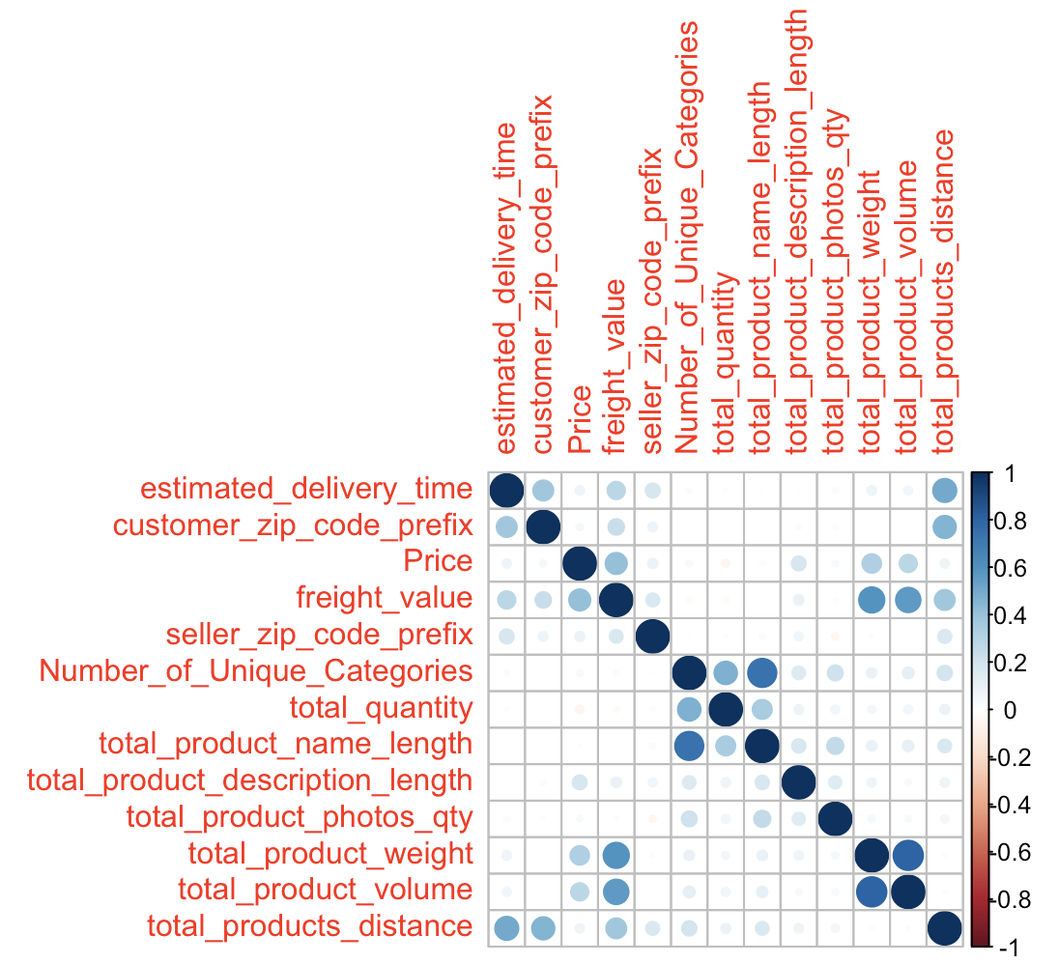
Appendix
Correlation Matrix

Slide 16
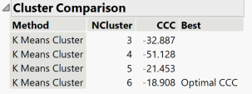
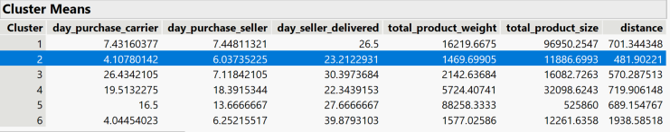
Appendix
Cluster Means

Slide 17
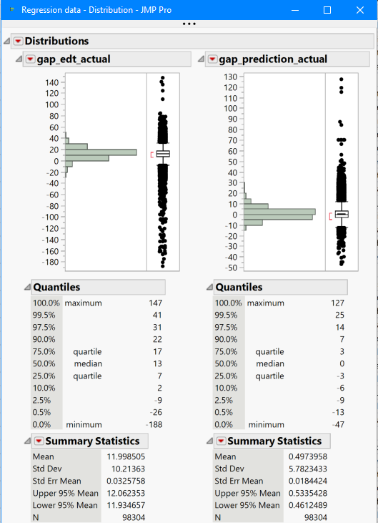
Appendix
Regression Model Distribution

Slide 18
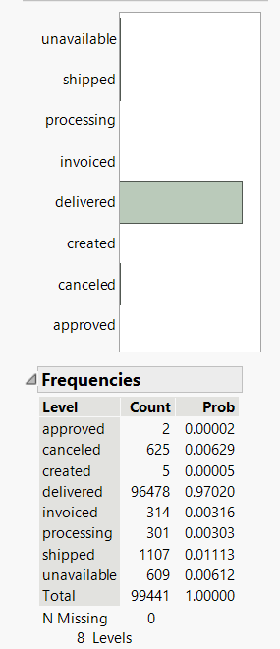
Appendix
SLA

Slide 19
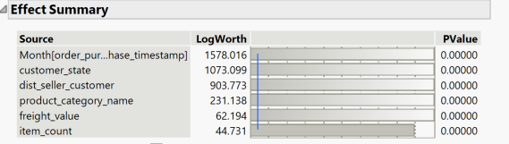

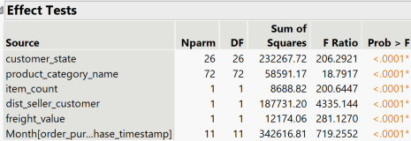
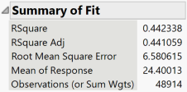
Appendix
Regression Model Outputs

